Slide 1
DSpace training
Item submission
Notes:
______________________________________________________________
______________________________________________________________
______________________________________________________________
______________________________________________________________
______________________________________________________________
______________________________________________________________
______________________________________________________________
______________________________________________________________
______________________________________________________________

Slide 2
Item submission
This module covers:
  Sign in to DSpace
  Start a new submission
  Choose a collection
  Describe the item
  Upload the file
  Check successful upload
  Verify submission
  Complete submission
  Practical exercise
Other modules cover
  Submission curation
  DSpace administration

Slide 3
About this module
Prerequisites
To complete this unit you will need to know:
your email address for this exercise
your password for this exercise
Audience
Library staff who need to curate items in DSpace
Note
Implementations of DSpace vary in appearance and particulars but the principles are the same. Do not be concerned if actual screens look slightly different to the slides.

Slide 4
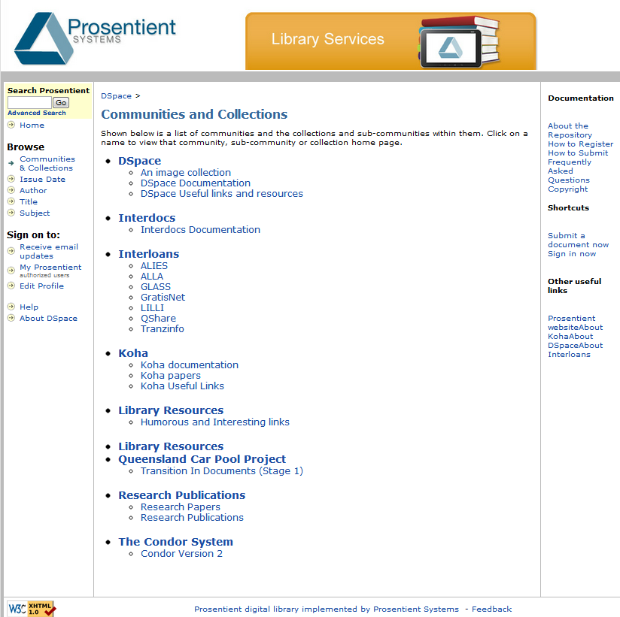
1. Sign into DSpace
To upload a document into DSpace you must be logged in.

Slide 5
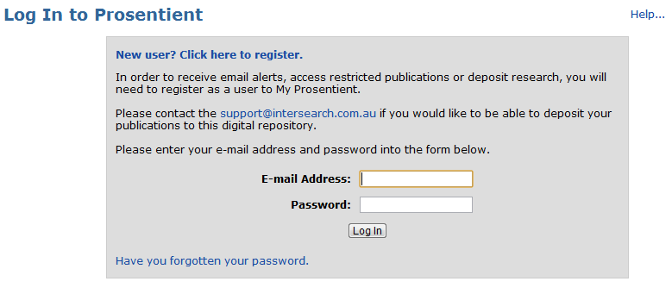
Sign into DSpace (cont.)
Click on My Prosentient on left hand side of the screen to see the log-in form:

Slide 6
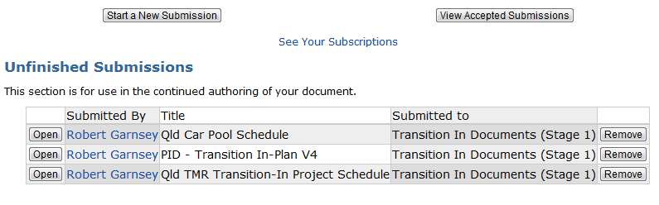
2. Start a new submission
Once logged in you will seen your personal home page. Click Start a New Submission to begin uploading.

Slide 7
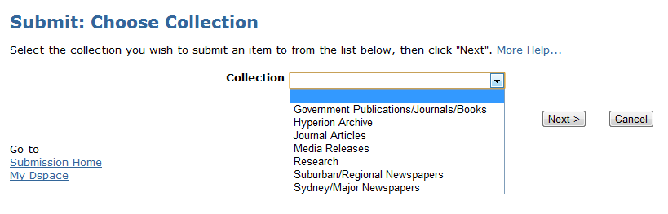
3. Choose a Collection
The first step in submission is to choose the collection that you want to submit to.

Slide 8
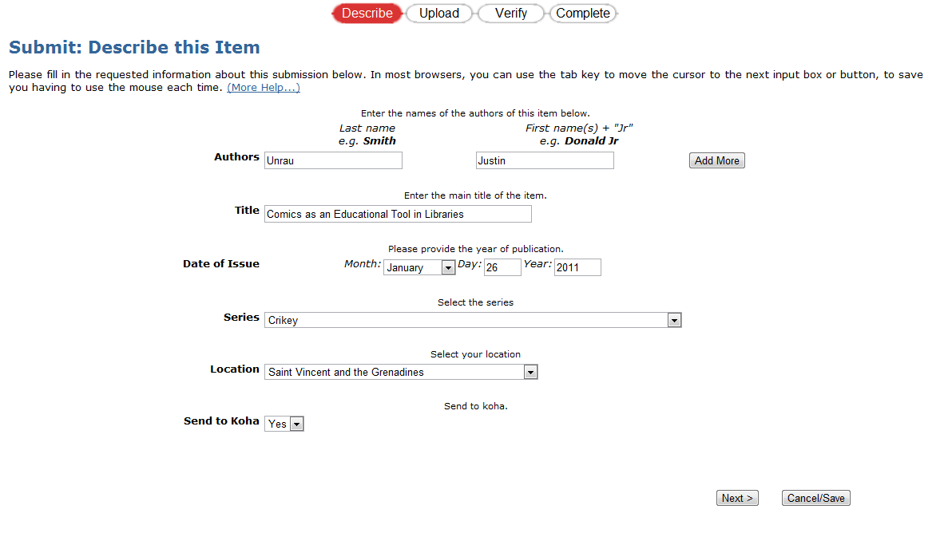
4. Describe the item
Enter the item’s metadata and click Next.

Slide 9
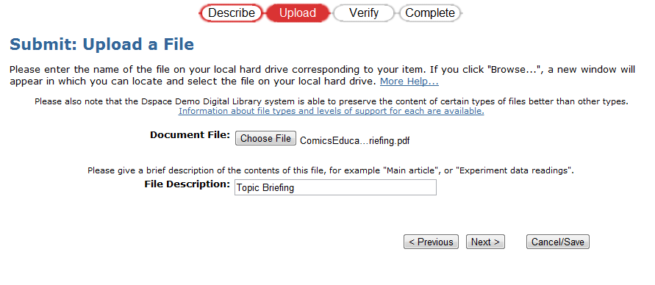
5. Upload the file
Click Choose File to select the item to be uploaded to the repository. Enter a brief description of the file’s contents in the File Description field, then click Next.

Slide 10
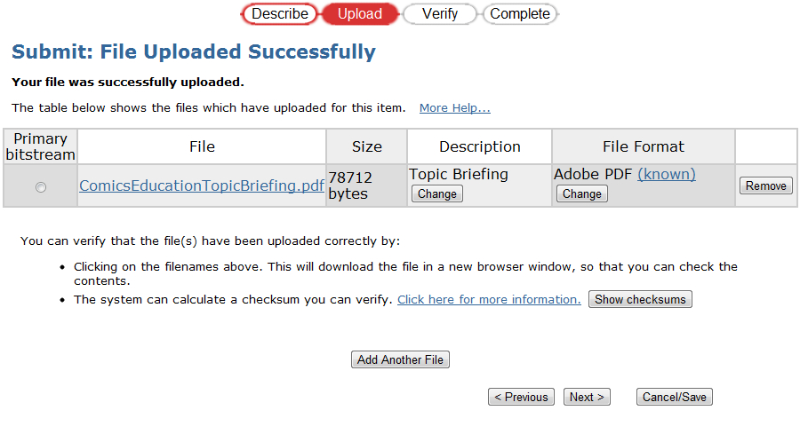
6. Check successful upload
Check and make sure the metadata is correct and change if necessary. Upload more files or click Next.

Slide 11
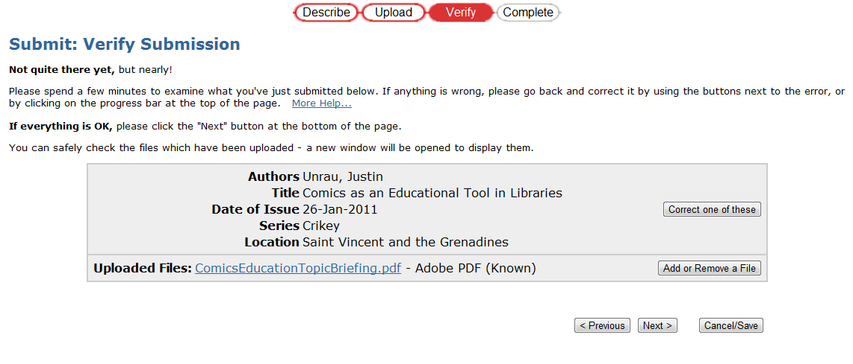
7. Verify submission
This step provides a final opportunity to review and change individual packages before they are committed to the repository. Click Next when ready to complete.

Slide 12
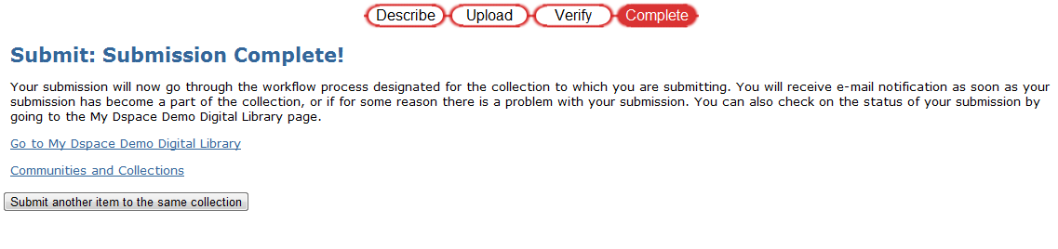
8. Complete submission
This screen indicates that the submission has been completed successfully.

Slide 13
Item Submission exercise
Follow the steps in the Item Submission Exercise sheet to upload an item to the repository.

