Slide 1
DSpace training
Submission curation
Notes:
______________________________________________________________
______________________________________________________________
______________________________________________________________
______________________________________________________________
______________________________________________________________
______________________________________________________________
______________________________________________________________
______________________________________________________________
______________________________________________________________

Slide 2
Submission curation
This module covers:
  Submission notification
  Tasks in the pool
  Accept a task
  Preview the task
  Make a decision
  Practical exercise
Other modules cover
  Item submission
  DSpace administration

Slide 3
About this module
Prerequisites
To complete this unit you will need to know:
your email address for this exercise
your password for this exercise
Audience
Library staff who need to curate items in DSpace
Note
Implementations of DSpace vary in appearance and particulars but the principles are the same. Do not be concerned if actual screens look slightly different to the slides.

Slide 4
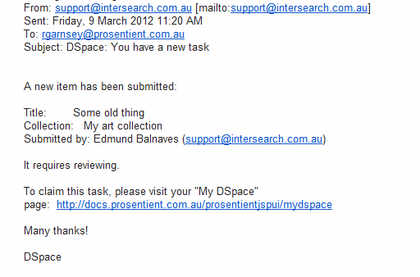
1. Submission notification
Depending on the configuration of a Collection, a submission will notify its curators that a submission is awaiting moderation.

Slide 5
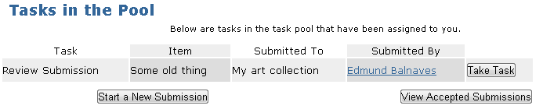
2. Tasks in the pool
On logging the link in the email and logging in to DSpace, the curator will see the Pool of submissions awaiting attention.

Slide 6
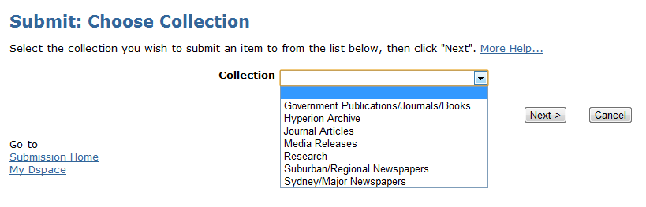
3. Accept a task
A Collection can have multiple curators, so the first taker is able to accept the task by clicking Take Task.

Slide 7
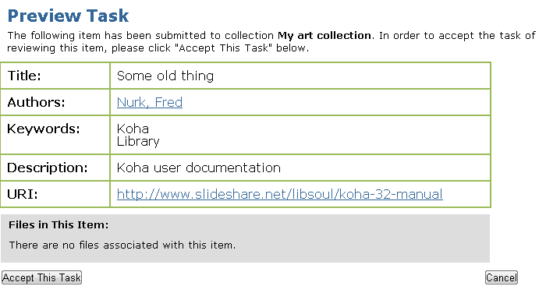
4. Preview the task
On accepting a task curator is given a preview of the item and the opportunity to confirm or cancel the task.

Slide 8
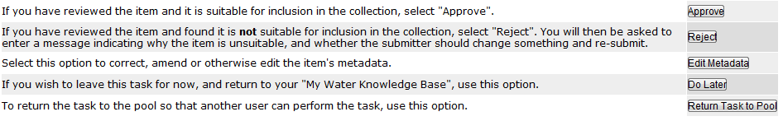
5. Make a decision
On confirming acceptance of the task, the curator is presented with a choice of four decisions.
Approval will see the item added to the repository immediately.
You can Edit the metadata after review – for instance to add subjects or correct errors.
Other choices mean rejection or deferral pending revision.
The submitter is advised of the curator’s decision by email. You can add a note to rejection emails – for instance asking for more details or a missed file upload.

Slide 9
6. Submission Curation Exercise
Follow the steps in the Submission Curation Exercise sheet to approve a submission to the repository.

