Slide 1
DSpace training
DSpace administration
Notes:
______________________________________________________________
______________________________________________________________
______________________________________________________________
______________________________________________________________
______________________________________________________________
______________________________________________________________
______________________________________________________________
______________________________________________________________
______________________________________________________________

Slide 2
DSpace Administration
This module covers:
Create role group
Create user
Create collection and workflow
Link item to other collection
Search for items
Pull an item
Change privileges
Other modules cover
  Item submission
  Submission curation

Slide 3
About this module
Prerequisites
To complete this unit you will need to know:
your email address for this exercise
your password for this exercise
Audience
Library staff who need to curate items in DSpace
Note
Implementations of DSpace vary in appearance and particulars but the principles are the same. Do not be concerned if actual screens look slightly different to the slides.

Slide 4
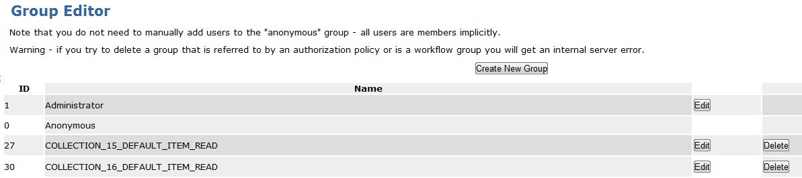
1. Create role group
To create a new role group, click the Groups link to display a list of existing groups.

Slide 5
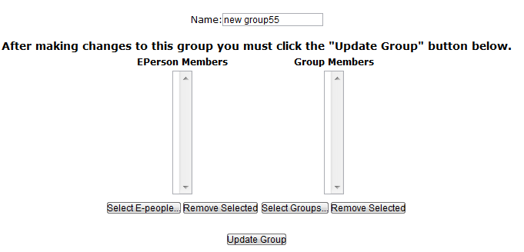
Create role group (cont.)
Click the Create New Group button to bring up a control panel. List box on the left allows the selection of e-people to add to the Group. List box on the right allows the selection of other groups to be given membership of this group, if required.
Give the group a name (following the naming conventions of the site) and click the Update Group button.

Slide 6
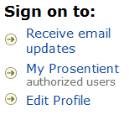

2. Create user
i) User self registration:
a new user can self-register by clicking a Sign on link, followed by Click here to register.
By providing an email address and following the instructions sent them by email, they can finish registering their details.
After registration is complete an Administrator can grant them the necessary access privileges.

Slide 7
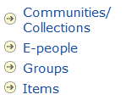
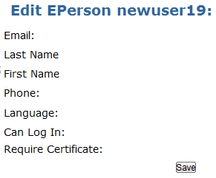
Create user (cont.)
ii) Administrator creates a user:
Log in and click Administer
Select the e-people link
Choose Add E-Person
Complete the user profile - the Language and Require Certificate fields are typically not required.

Slide 8
Create user (cont.)
To add the user to a role group, first click the Groups link to see a list of all existing groups.

Slide 9
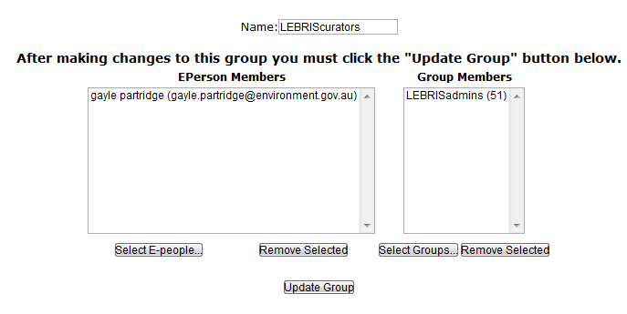
Create user (cont.)
Identify the Group to which you want to add this user and click Edit to bring up a control panel.
The list box on the left allows you to select e-people to add to this group, while the list box on the right allows you to make other groups members of this group.
Click Select E-People to see a list of users and click the Add button next to the member you wish to be added.

Slide 10
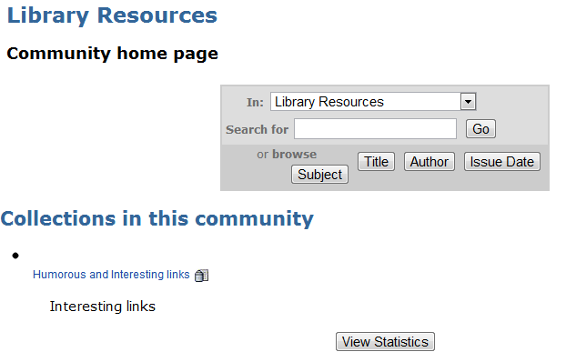
3. Create Collection and workflow
While logged in as Administrator, click on Communities and Collections at the head of the left hand menu on the Administration Tools page.
Then click on the name of the Community under which you intend to create the new Collection.

Slide 11
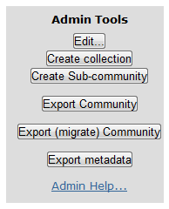
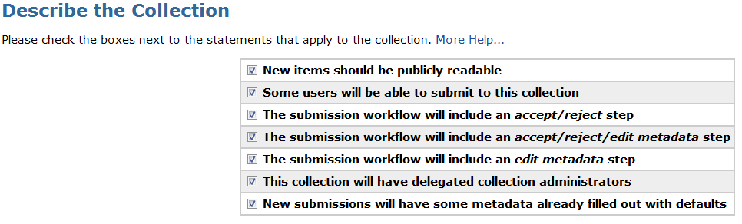
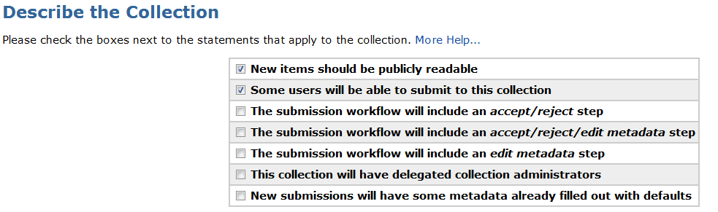
Create Collection and workflow (cont.)
Click on Create Collection, found under the Admin Tools menu on the right of the screen.
Leave checkboxes on Page 1 of Describe the Collection as currently checked, unless specific reason to customise.
Click the Next button.

Slide 12
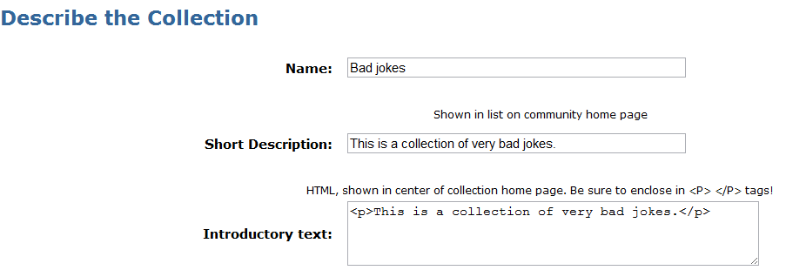
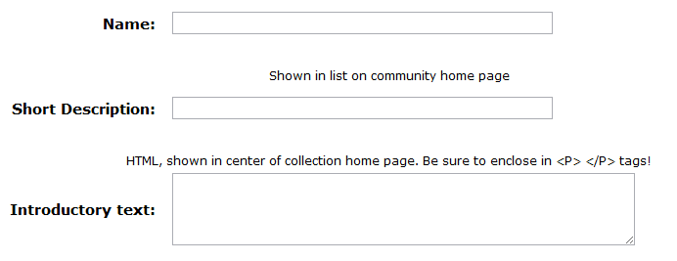
Create Collection and workflow (cont.)
Complete the form on Page 2 of Describe the Collection. Just complete the mandatory Name , Short Description and Introductory Text fields unless specific reason.
Click the Next button.

Slide 13
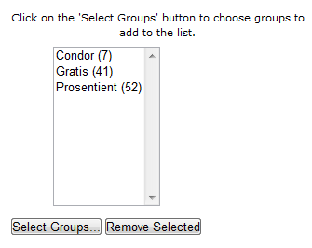
Create Collection and workflow (cont.)
The Authorisation to Submit page allows selection of individual users or role groups that will be allowed to update this Collection.
It is usually preferable to authorise role groups than individuals.
Use the controls to select e-people or groups allowed to submit documents to this collection, and click Next.

Slide 14
Create Collection and workflow (cont.)
Now we are on the Edit collection page. Scroll down to the the Submission Workflow section where we specify the Collection’s Administrators.
By now you will be familiar with the control panel and how to select the group/s or e-people who are to have full control over this collection.
When finished, click the Update Group button and return to the Edit collection page.

Slide 15
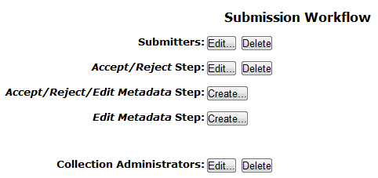
Create Collection and workflow (cont.)
While on the Edit collection page, if you have read and understood the topic and want to implement submission workflow on this Collection, then optionally edit one or more of the 3 workflow steps to specify one or more e-people/groups who are to perform the curator (reviewer, gatekeeper) role as appropriate.
Click Update to return to the DSpace Community home page.

Slide 16
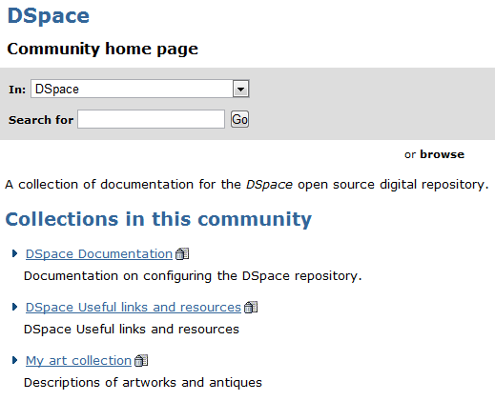
Create Collection and workflow (cont.)
On clicking Update and returning to the DSpace Community home page, you will see that a new Collection has just been created:

Slide 17
4. Link items to other Collection
You can link an item so that it appears in multiple collections.
Follow these steps:
Log in as an Administrator
Go to Communities and Collections
Click on the collection into which to what to link the document
Click on the Item Mapper button (to the right)
Search on the author of the article you wish to link (use the exact author name – it is VERY sensitive)
Checkbox the items and click ADD

Slide 18

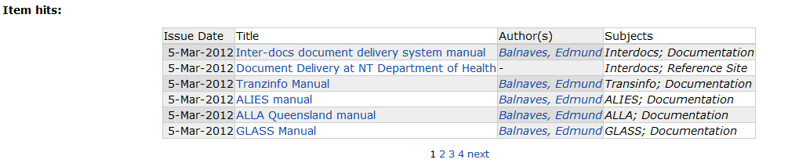
5. Search for items
To locate an item in the repository, type a keyword into the search box.
A result list of matching records is displayed.
To view a record in the result list, click on the document title.

Slide 19
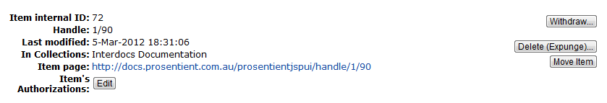
6. Pull an item
To withdraw (hide) or expunge (delete) an item in the repository, first view the record and then click the Edit button next to the record identifier
On the Edit Item screen select the appropriate pull function.

Slide 20
7. Change privileges
This is an advanced function that allows you to (for instance) mark all items in a given collection for non-public access, or to change ownership by groups.

Slide 21
DSpace Administration exercise
You will be provided with a DSpace administration exercise sheet to undertake a number of DSpace administration tasks.

